Slide 1
Week 6 (5) – AVL Trees
CST370 – Design & Analysis of Algorithms
Dr. Byun
Computer Science

Slide 2
Lecture Objectives
After completion of this lecture, you will be able to
  understand the problem of skewed binary search tree and explain the basic concepts of the AVL tree.
  perform a rotation to insert a new node into the AVL tree.

Slide 3
Chapter 6: Transform-and-Conquer
6.1 Presorting
6.2 Gaussian Elimination
6.3 Balanced Search Trees
6.4 Heaps and Heapsort
6.5 Horner’s Rule and Binary Exponentiation
6.6 Problem Reduction

Slide 4
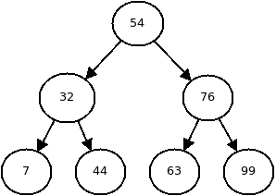
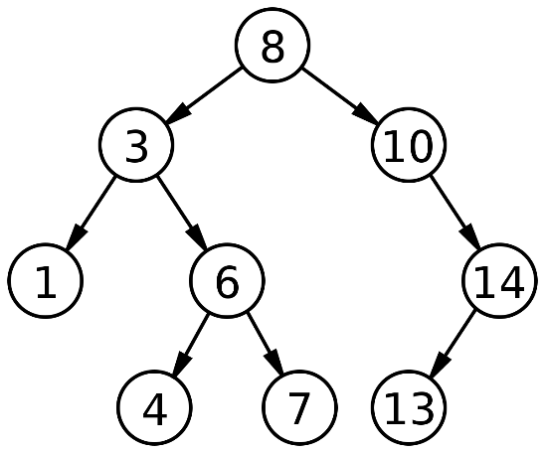
Binary Search Tree
Binary search trees provide efficient insert, delete, and search operations.
Example
Source: http://cs.umw.edu/~finlayson/class/fall12/cpsc230/notes/17-binary-search-trees.html
Source: https://en.wikipedia.org/wiki/Binary_search_tree

Slide 5
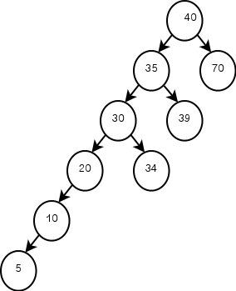
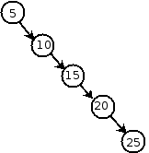
Binary Search Tree – Issue
One problem with binary search trees is that if the tree is too unbalanced (= skewed), the operation can take linear time (= O (n)).
Example
Source: http://ycpcs.github.io/cs201-fall2015/lectures/binarySearchTrees.html
Source: http://blogs.perl.org/users/ovid/2013/02/red-black-trees-in-perl-6-explained.html
Source: http://epaperpress.com/sortsearch/bin.html

Slide 6
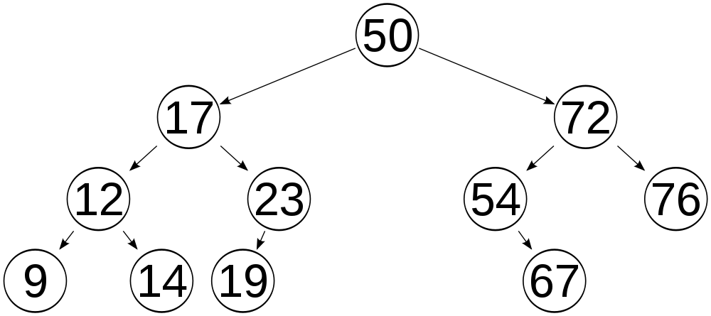
AVL Tree
The AVL tree is a balanced binary search tree and the difference in height between the left and right subtrees is less than or equal to 1.
  The difference is called balance factor (or balancing factor).
Example
Source: https://www.quora.com/Is-the-root-node-of-an-AVL-tree-or-any-height-balanced-tree-always-the-median-of-the-list-for-an-odd-number-of-elements

Slide 7
<<< Course Instruction >>>
Watch this video to understand the problems in the binary search tree and get the definition of the AVL tree.
  https://goo.gl/iBVYhT
  It’s important to understand this video because you will learn other topics of AVL tree based on it.

Slide 8
Exercise
Is this an AVL tree?
Do not see the answer immediately.
  Try to solve it by yourself.
50
30
70
10
90

Slide 9
Solution
Yes, it’s an AVL tree because each node's balance factor is -1, 0, or 1.
  The red number next to each node is the balance factor of the node.
0
50
1
-1
30
70
0
0
10
90

Slide 10
Exercise
Is this an AVL tree?
Do not see the answer immediately.
  Try to solve it by yourself.
50
30
70
10
60
90

Slide 11
Solution
No, it’s not an AVL tree because it’s not a binary search tree.
  Pay attention to the node 60.
  In order to be an AVL tree, it must be a binary search tree in addition to meeting the balance factor requirements.
50
30
70
10
60
90

Slide 12
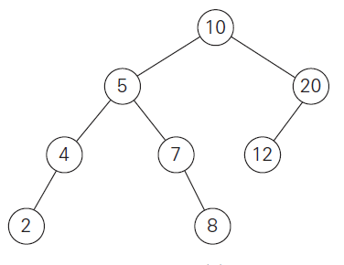
Exercise
Is this an AVL tree?
Do not see the answer immediately.
  Try to solve it by yourself.

Slide 13
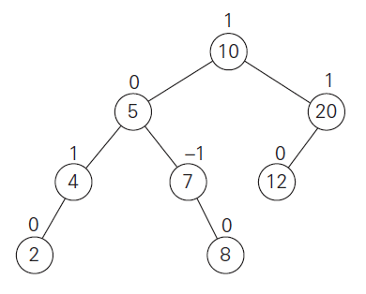
Solution
Yes, it’s an AVL tree because each node's balance factor is -1, 0, or 1.
  You may feel that the tree is not well balanced. But it’s an AVL based on the definition of AVL tree.

Slide 14
<<< Course Instruction >>>
Rotations
  After inserting a new node, if the AVL tree becomes unbalanced, it will rotate to balance it.
  There are four different rotations.
Watch this video to understand how 4 rotations are performed.
  https://goo.gl/wq5Xe2
  This is a difficult concept, especially LR and RL rotations.
  If you don’t understand, watch the video again.

Slide 15
Exercise
Assume that you have an AVL tree as shown below.
  Insert a new node “90” into the tree.
  What rotation is needed and what is the result?
Do not see the answer immediately.
  Try to solve it by yourself.
50
70

Slide 16
Solution (1 of 2)
This is the result of inserting node 90 into the tree.
  Since the balance factor of node 50 is -2, this is not an AVL tree.
  You need the L rotation to fix it.
-2
50
-1
70
0
90

Slide 17
Solution (2 of 2)
This is the result of the L rotation.
0
70
0
0
50
90

Slide 18
Exercise
Assume that you have an AVL tree as shown below.
  Insert a new node “60” into the tree.
  What rotation is needed and what is the result?
Do not see the answer immediately.
  Try to solve it by yourself.
50
70

Slide 19
Solution (1 of 2)
This is the result of inserting node 60 into the tree.
  Since the balance factor of node 50 is -2, this is not an AVL tree.
  You need the RL rotation to fix it.
-2
50
1
70
0
60

Slide 20
Solution (2 of 2)
This is the result of the RL rotation.
0
60
0
0
50
70

Slide 21
<<< Course Instruction >>>
A series of rotations
  In real life situations, multiple rotations are required when several nodes need to be inserted.
Watch this video to understand how multiple rotations can be conducted in the AVL tree.
  https://goo.gl/zt7Wiq

Slide 22
Exercise
Assume that you have an AVL tree as shown below.
  Insert a new node “5” and then “10” into the tree.
Do not see the answer immediately.
  Try to solve it by yourself.
50
30
70
20

Slide 23
Solution (1 of 4)
This is the result of inserting node 5 into the tree.
  Since node 30 is the first violating node with balance factor 2, an R-rotation must be performed to resolve it.
50
2
30
70
1
20
0
5

Slide 24
Solution (2 of 4)
This is the result of R rotation.
1
50
0
0
20
70
0
0
5
30

Slide 25
Solution (3 of 4)
Now, let’s insert a new node 10.
  This is the result of inserting node 5 into the tree.
  Since node 50 is the first violating node with balance factor 2, an R-rotation must be performed again to resolve it.
2
50
1
0
20
70
-1
0
5
30
0
10

Slide 26
Solution (4 of 4)
This is the result of R rotation.
0
20
-1
0
5
50
0
0
0
10
30
70

Slide 27
<<< Course Instruction >>>
Read pages 218-223 in the textbook and proceed to the next slide.
  If you fully understood the three videos, our textbook will be straightforward.

Slide 28
<<< Course Instruction >>>
This lecture is over.
  The due of homework 5 is Feb 11 (Tue) 11:55 pm.
  Next week's lecture notes will be available on Wednesday, Feb 12, at or before 10:00(AM).
Reminder
  The midterm-II is on Feb 15 (Saturday) at 10:00(AM).

